Slide 1

E-COMMERCE SALES DASHBORD
Presented By:
Sajid Ali
Date:
17/09/2026

Slide 2

Problem Statement/Overview
The E-commerce dataset contains 5,000 sales orders.
The dashboard helps analyze sales, profit, quantity and orders.
It makes important business information easier to understand.

Slide 3



Sales and marketing teams
Business managers and decision makers
Data analysts and management students
Who will use This dashboard ?

Slide 4
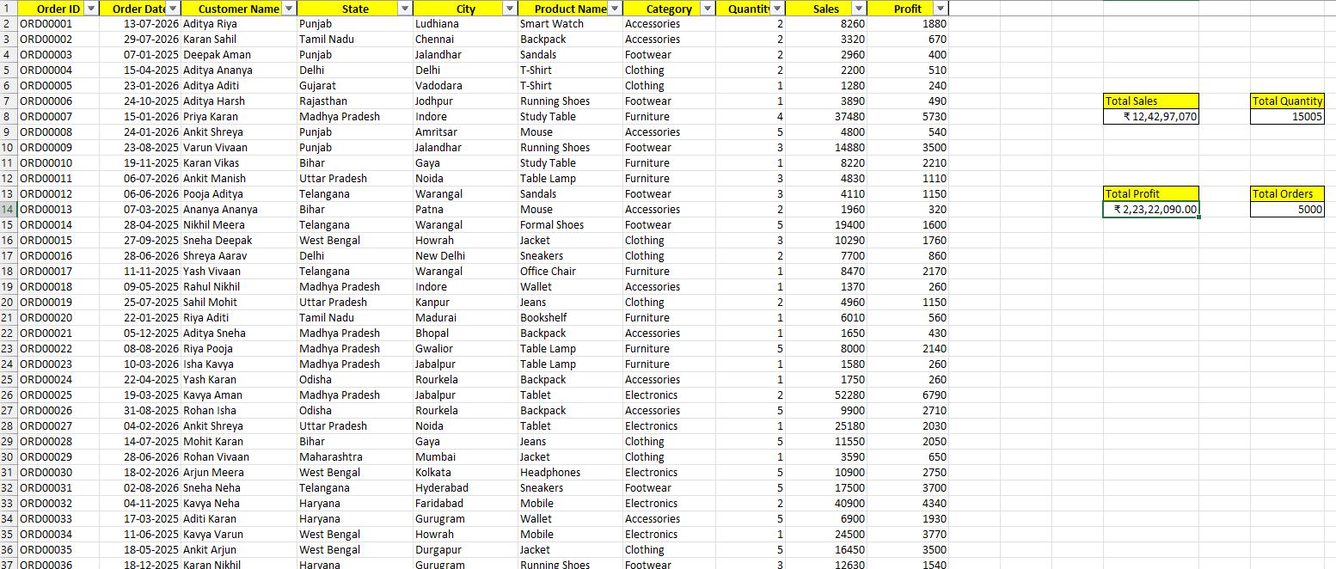
Data Overview
Total Orders: 5,000
Total Quantity: 1,505
Total Sales: 12,42,97,070
Total profit: 2,23,22,090
Main fields include Order Date, State, City, Category, Product and Customer.

Slide 5
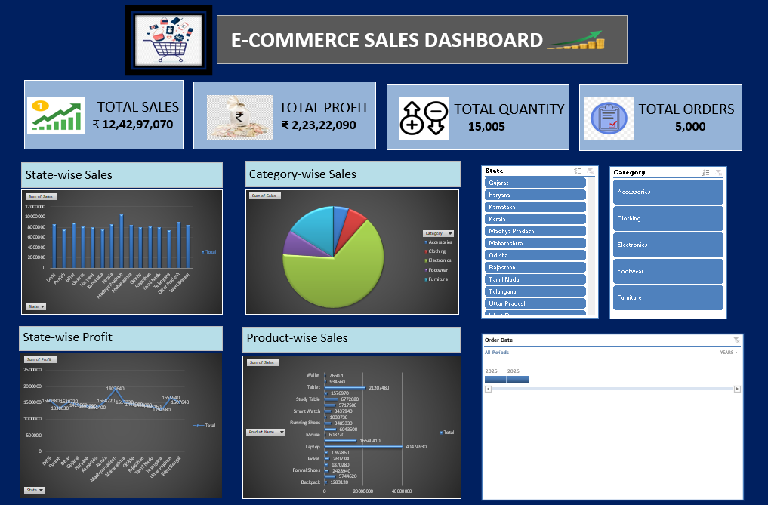
Dashboard Design
KPI cards show Total Sales, Total Profit, Total Quantity and Total Orders.
Charts show State-wise Sales, Category-wise Sales, State-wise Profit and Product-wise Sales.
Slicers and provided for State, Category and Order Date

Slide 6
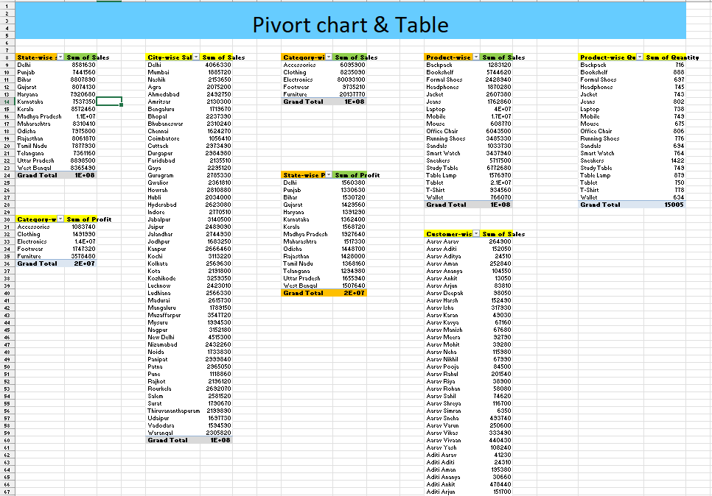
Key insights
Electronics is one of the strongest sales categories.
Sales performance varies across states and cities.
Profit trends can be compared using the State-wise Profit chart.
Product-wise analysis helps identity high-Performance products.

Slide 7

Key Insights – KPI
Summary
Total Sales: 12,42,97,070
Total Profit: 2,23,22,090
Total Quantity: 1,505
Total Orders: 5,000

Slide 8

Future Enhancements
Add monthly and yearly Sales trend analysis.
Add profit margin and average order value KPIs.
Add more interactive filters and drill-down analysis.
Add target vs actual performance indicators

Slide 9
Conclusion
The dashboards gives a clear overview of e-commerce performance.
It combines KPIs charts and filters in one place.
It can support faster and more informed business decisions.
Thank You

